Slide 1
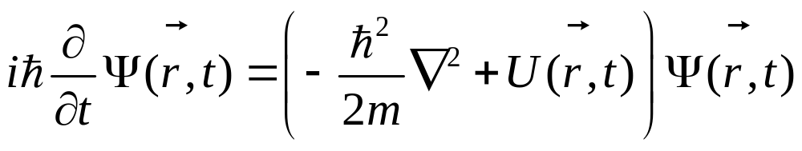
氢原子的量子力学理论
1926年，Erwin Schrodinger给出了一个微观粒子在势场U(r,t)低速时波函数满足的方程，称为薛定谔方程
玻恩给出了波函数的概率解释
波函数的平方表征了t 时刻，空间(x,y,z)处粒子出现的概率密度

Slide 2
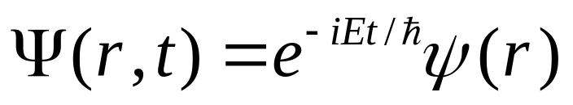
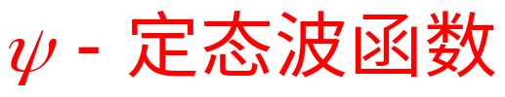
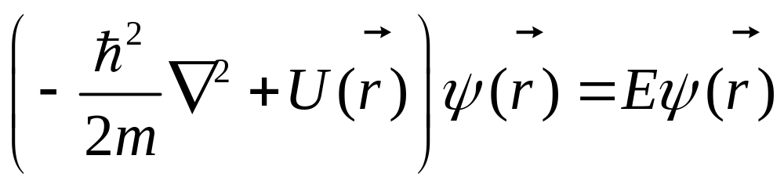
定态薛定谔方程
如势能函数不是时间的函数,用分离变量法将波函数写为：
得：定态薛定谔方程

Slide 3
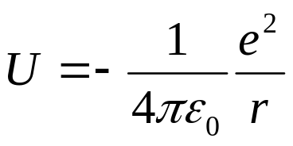
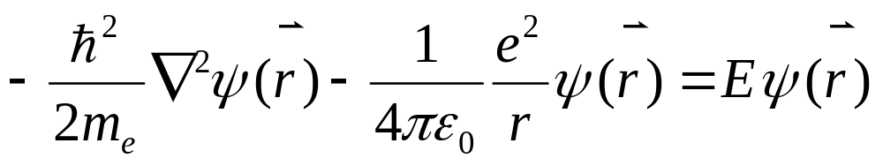
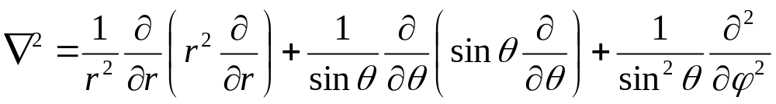
氢原子是两体问题，可以通过坐标的选取化为折合质量为m=m_{e}m_{p}/(m_{e}+m_{p})的单体问题，从而给出其薛定谔方程。
氢原子中的电子在核电场中运动，其电势能为：
势能函数不显含时间，只需求解定态薛定谔方程

Slide 4
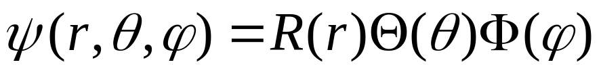
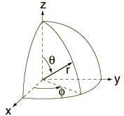
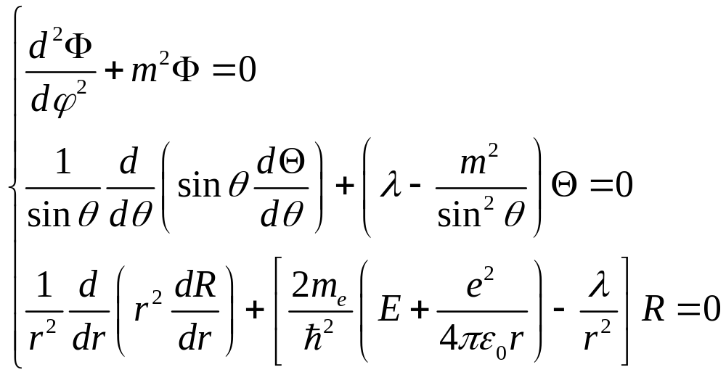

势能具有球对称性，采用球坐标系，这时方程可分离变量
在能量E < 0的情况下，可解出方程满足标准条件
(单值、有限、连续)的非零解，
由此得到三个量子数 n、l、m

Slide 5
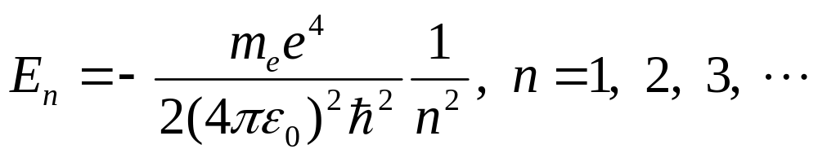
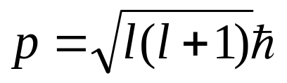
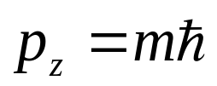
确定氢原子定态波函数的三个量子数n、l、m
（1）主量子数 n
（2）角量子数 l
对于一个确定的 n 值，l = 0，1，2，…，n - 1，λ = l(l+1)
氢原子系统的轨道角动量
（3）磁量子数 m
对于一个确定的 l 值，m = l ， l - 1，…，0， … ，- l ，
氢原子系统的轨道角动量的 z 分量

Slide 6
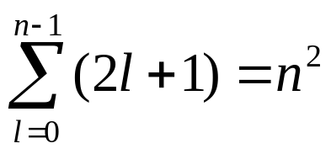
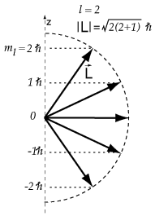
氢原子的能级和波函数
氢原子的能级
每一组量子数（nlm）对应一个确定的定态
能级只与主量子数 n 有关，与 lm 无关，能级是简并的。
简并度
氢原子的轨道角动量
角动量的分量总小于角动量本身
氢原子的定态波函数
径向函数
球谐函数

Slide 7
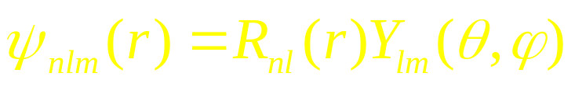
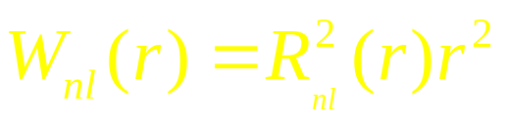
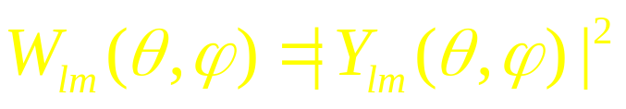
电子波函数的径向分布和角分布
电子的能量本征函数为径向函数和球谐函数的乘积：
电子的径向分布
电子的角分布

Slide 8
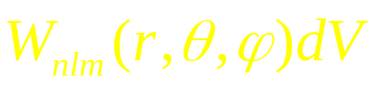
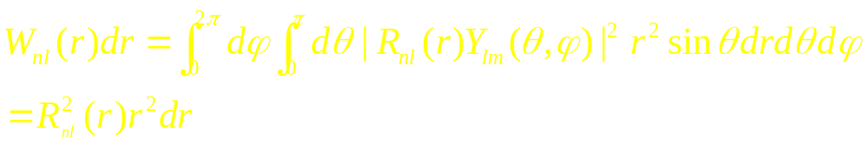
设在空间（r,θ,φ）处体积元 dV 处发现电子的几率为
W_{nl}(r)为沿径向在r到r+dr之间发现电子的几率
所以，电子的径向分布为

Slide 9
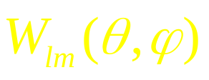
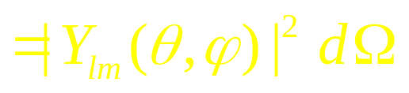
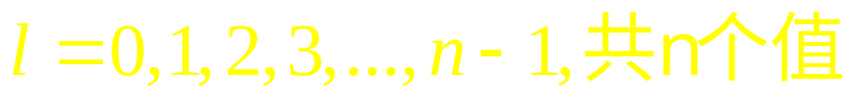
定义 为电子的角分布:
电子的角分布
角量子数:

Slide 10
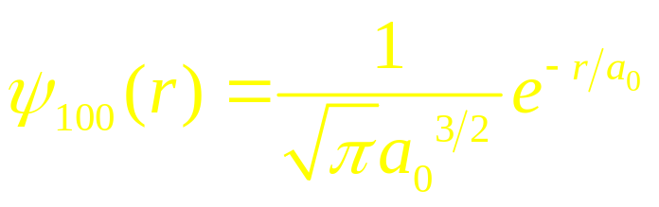
氢原子的基态波函数：
三个量子数n, l, m:
n：主量子数；
l：角量子数；
m：磁量子数；
通常，将 l = 0的态称为s态， l = 1, 2, 3,…的态依次称为 p, d, f, …态，处于这些态的电子依次称为s, p, d, f,…电子。

Slide 11
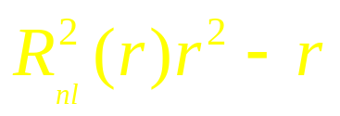
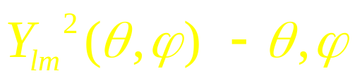
电子波函数的径向分布和角分布
- 电子的径向分布作图
从径向表示电子云在空间的分布规律。
物理意义:
在半径为r到r+dr的球壳内找到电子的概率
- 电子的角分布作图
从角度表示电子云在空间的分布规律。
物理意义:
在(θ,φ)附近单位立体角内发现电子的概率 (r从0到∞)

Slide 12
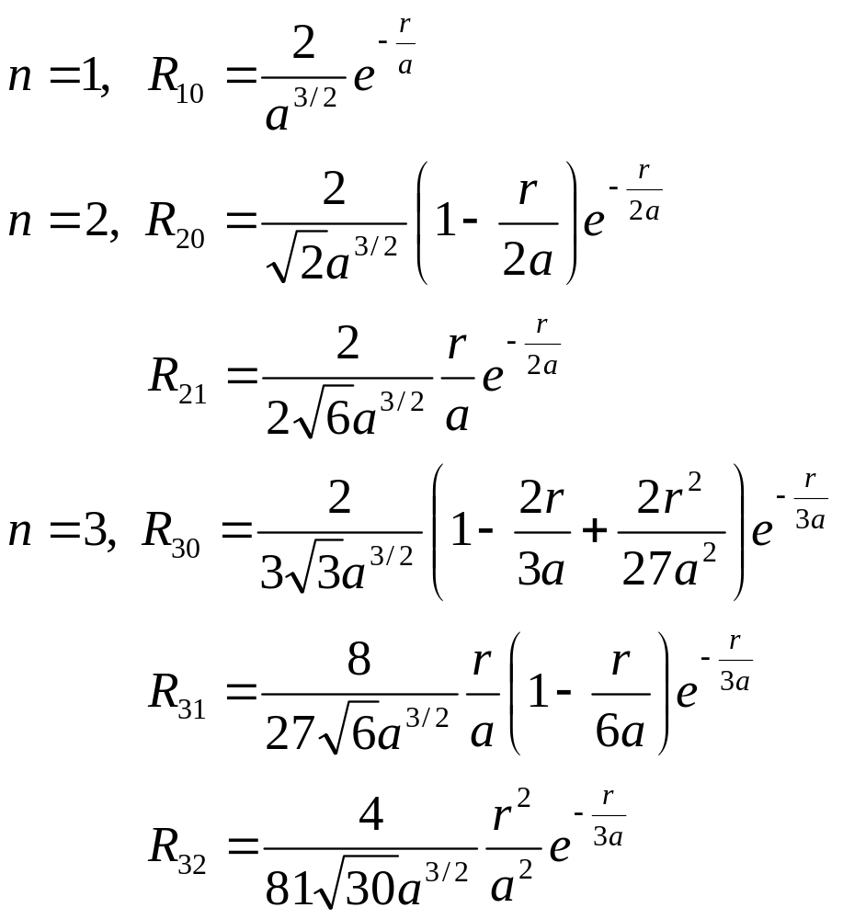
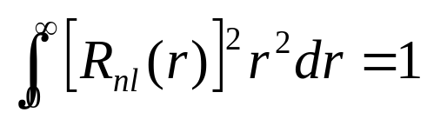
氢原子最低几条能级的归一化径向波函数

Slide 13
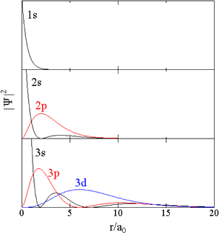
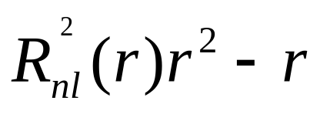
电子云径向密度分布图
径向概率分布
物理意义:
在半径为r到r+dr的球壳内找到电子的概率

Slide 14
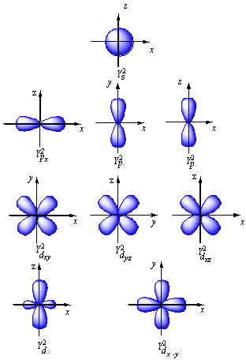
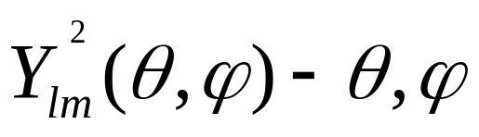
电子云角向密度分布图
角向概率分布
物理意义:
在(θ,φ)附近单位立体角内发现电子的概率 (r从0到∞)

Slide 15
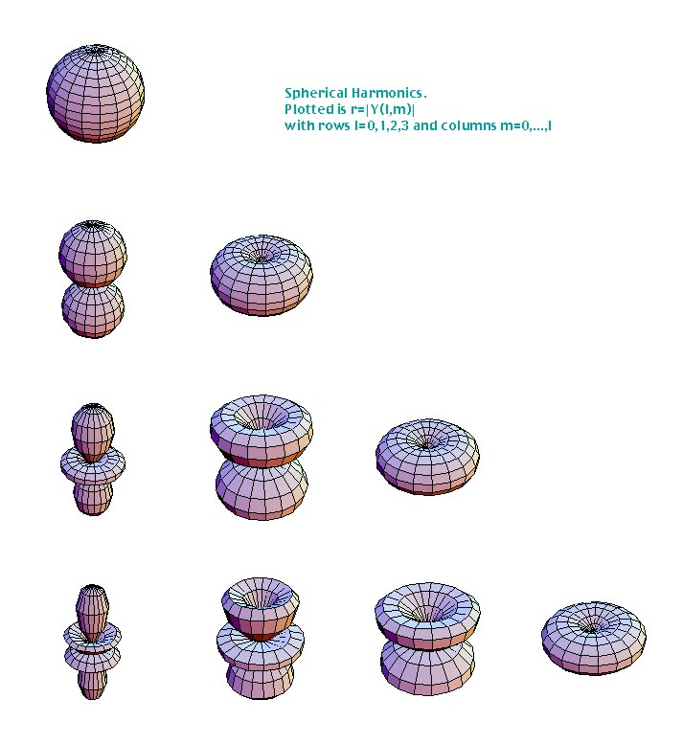










粒子概率分布随角度的变化|Y_{lm}|²，与φ角无关

Slide 16
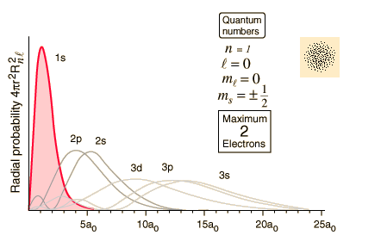
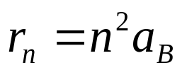
氢原子径向波函数
径向波函数用 nl 标记，l = 0，1，2，分别用 s，p，d表示
径向波函数的节点数为 n - l - 1
圆轨道：节点数为零的态
极大值对应玻尔半径

Slide 17
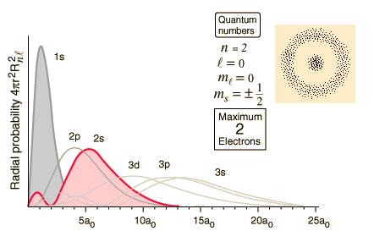
氢原子径向波函数

Slide 18
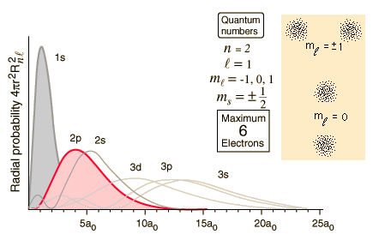
氢原子径向波函数

Slide 19
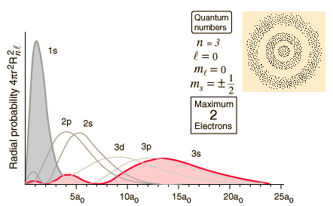
氢原子径向波函数

Slide 20
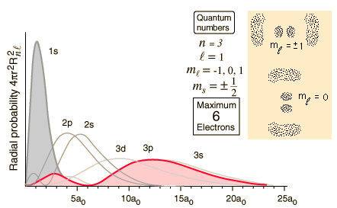
氢原子径向波函数

Slide 21
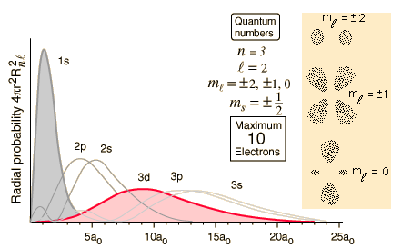
氢原子径向波函数

Slide 22
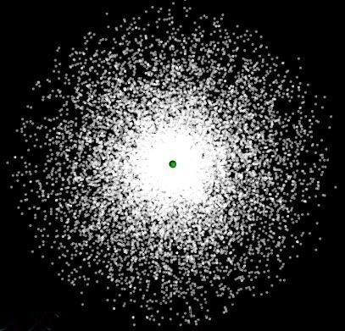
电子云

Slide 23
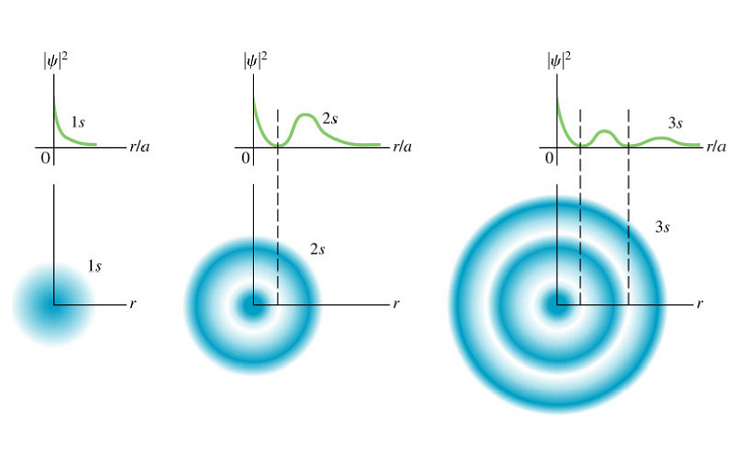
氢原子电子云

Slide 24
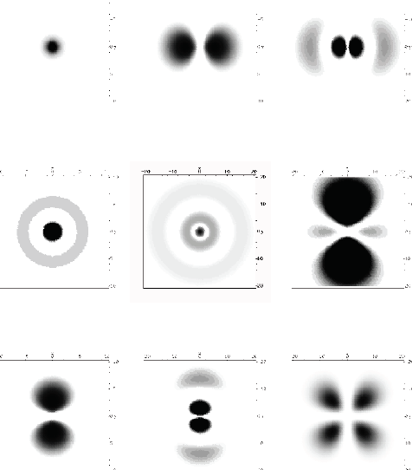


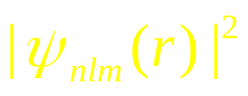
当n=1,2,3时，电子的空间分布

Slide 25
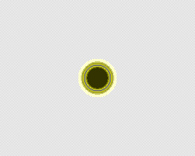
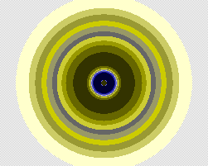
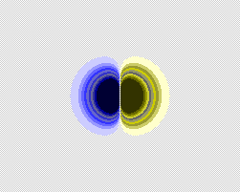
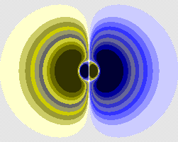

Slide 26
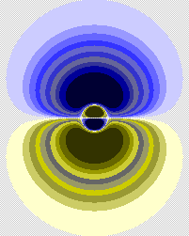


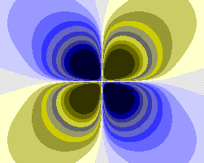




Slide 27

氢原子的电子云的概率密度

Slide 28

氢原子电子云的完整图形
1s 电子云

Slide 29

氢原子电子云的完整图形
2s 电子云

Slide 30


氢原子电子云的完整图形
3d 电子云

Slide 31

复杂的电子衍射像

Slide 32


Quantum Mechanics and Probability Clouds

Slide 33

Rutherford Model of the Atom
Based on his alpha-particle scattering experiment on gold, Rutherford concluded that the atom consisted of a hard central core where most of the mass of the atom rested.
Hydrogen was the earliest atom, formed when
quarks and an electron came together shortly
after the Big Bang.
Other heavier atoms were formed by smashing
hydrogen atoms together; this took place in the
early stars.
There are 88 naturally occuring basic types of
atoms--called elements.
Carbon (C), hydrogen (H), oxygen (O),
and nitrogen (N) are the four most abundant
elements in living things.

Slide 34

Nuclear Structure
Facts about the nucleus:
Protons and neutrons have roughly the
same mass, and each is about 2000
times as massive as the electron.
The number of protons is the same
as the number of electrons (not shown)
which orbit the nucleus.
For any given element, all nucleii
have the same number of protons,
but the number of neutrons will
vary.

Slide 35

Relative Size of Nuclei
One fermi (fm) = one billionth of a meter / million

Slide 36

Molecules, Atoms, and Nuclei

Slide 37


Structure of Sub-Atomic Particles

Slide 38

Nuclei, Nucleon, and Quarks

Slide 39

Line Spectra

Slide 40

Atomic Spectra
Atoms in heated gases emit and absorb light of certain wavelengths.
Shown at the above are three emission spectra and one absorption spectrum.

Slide 41


Neils Bohr Explains the Hydrogen Atom
Neils Bohr, a Danish physicist, treated the
hydrogen atom as if it were an electron of
charge -e orbiting in a circular path about
a proton of charge +e.

Slide 42

Energy Levels in Hydrogen

Slide 43

Energy Transitions in Atoms
Energy of photon = Energy lost by electron

Slide 44


deBroglie Wave
Louis deBroglie:
Hydrogen Electrons Behave Like Waves
An integral multiple of
wavelengths must fit
in the length 2pr,
otherwise destructive
interference would
occur.

Slide 45

DeBroglie Waves in Bohr's Model

Slide 46
§7.3 电子自旋
氢原子的量子力学理论可以很容易的推广到类氢原子和离子，如He⁺，碱金属原子，都可以看成是一个电子和一个等效正电荷为Z的原子核构成的系统
利用这些理论可以很容易的给出类氢原子或离子的光谱，如钠的光谱
利用这些理论也可以给出具有轨道角动量l的类氢原子或离子在外加磁场作用下的效应
而这些都是实验可以检验的推论

Slide 47
实验表明尽管总体上理论和实验符合的还可以，但仍存在偏差
如钠黄光按照理论应只有一条分立的谱线，但是精细的实验测量表明实际上是两条靠得很近的分立谱线(5890A,5896A)，即存在精细结构。同样氢原子光谱也存在这种精细结构
又如银原子在磁场作用下发生偏转，由于轨道角动量l为整数，所以应观测到奇数(2l+1)条分立斑，但实际观察到2条分立斑
这说明理论需要修正

Slide 48



Slide 49




斯特恩-格拉赫实验
电子的轨道角动量带有一定的磁矩
设原子处于沿z方向的非均匀磁场中，
电子沿磁场方向的磁矩为μ，
磁矩所受的合力为
设原子以速度v、垂直磁场
穿越的距离为L，于是原子
在 z 方向的偏转为
电子的磁矩取值连续，偏转连续；取值量子化，偏转量子化

Slide 50

在电子自旋提出以前，1922年施特恩-格拉赫完成了一个重要实验
实验装置及结果
原子炉中产生高温的银原子束，经过准直后通过非均匀磁场。
银原子只有一个价电子，内层电子有46个。

Slide 51



电子自旋修正
George E. Uhlenbeck
1900-1988
Samuel Abraham Goudsmit
1902-1978
理论与实验的偏差表明原子中存在一种原先未曾考虑的相互作用。1925年乌伦贝克和古兹密特类比行星的运动，提出电子自旋概念，认为电子除了绕核运动之外，还存在自旋运动，由于电子带电，因而有自旋磁矩。1，自旋磁矩与电子轨道运动磁矩的相互作用造成原子能级的分裂；2，自旋磁矩附加在原子磁矩上，在磁场中造成原子能级的复杂分裂。
根据光谱的资料分析，推测自旋量子数为1/2

Slide 52

自旋轨道耦合项

Slide 53
更精细的实验表明氢原子光谱还有超精细结构，兰姆位移等现象。
超精细结构源于原子核自旋的影响
兰姆位移则需要考虑真空极化作用，这在Schwinger, Feynman, and Dyson发展了量子电动力学(Quantum ElectroDynamics)以后才得以解释
QED是目前最完美的电磁相互作用理论

Slide 54
§7.4 泡利不相容原理和电子壳层结构
在了解氢原子的量子力学理论之后，我们可以试着将我们的研究对象变的复杂一些，即考虑He原子
其复杂性来源于两个电子，加上原子核之后成为三体问题，事实上我们没有好的办法来严格求解，而只能近似求解
假设新加入的电子对原来一个电子和一个原子核构成的体系的波函数和能级结构影响较小，并且两个电子的地位是相同的
这样一来问题就简化为两个电子在一系列能级上的占据问题

Slide 55


电子壳层结构
电子能够占据的一系列能级可以看成是一系列壳层结构
电子具有自旋，原子中电子态用四个量子数来描述：n，l，m，m_{s}
原子中的电子，按主量子数 n 的不同，分成不同的壳层，
具有相同主量子数 n 的电子处于同一壳层中。
在一个壳层中，对不同的角量子数 l 又可分为不同的支壳层，
同一个支壳层的量子数 n 和 l 相同。
每个支壳层的电子态数
每个大壳层的电子态数

Slide 56

32
角动量量子数l 习惯上用字母来表示
18
0, s
1, p
2, d
3, f
4, g
8
2

Slide 57

电子壳层结构
在自旋轨道耦合的情况下，电子态用n，l，j，m_{j}四个量子数描述
原子中的电子，按主量子数 n 的不同，分成不同的壳层，
具有相同主量子数 n 的电子处于同一壳层中。
电子态用不同的量子数描述，电子态数相同
壳层概念只是因为能级分布有相对集中的趋势，从而提出的概念，特别是主壳层最明显，对于支壳层，不必太当真，因为经常有不同支壳层交叉的现象。壳层概念对理解元素周期表有帮助。

Slide 58
泡利不相容原理
有了能级的壳层结构概念以后，对于He原子来说，可以将其近似为两个电子按一定规则填充到相应量子态上
一个很严重的问题是，两个电子能否填充同一个量子态？能填充到同一个量子态和不能填充到同一个量子态对应的原子性质是不同的，
如果He的两个电子和氢原子的电子处于同样的态，那么其化学性质也应如氢原子一样活泼，但事实上He被称为惰性气体
而从能级结构上看，能量最低的n=1壳层对应有两个态，如果He的两个电子恰好填在这两个态上，则对应的化学性质比较稳定，事实上2就是原子结构中的一个幻数，即惰性气体的核外电子数

Slide 59

泡利原理
1924年泡利提出不相容原理：在一个原子中不可能有两个或两个以上的电子处于完全相同的量子状态，也就是说，在一个原子内部不可能有两个或两个以上的电子具有完全相同的四个量子数。
Wolfgang Pauli
1900-1958
自旋是半整数的粒子称为费米子，自旋是整数的粒子称为玻色子
一个量子态只能填布一个费米子，但能填布任意多的玻色子

Slide 60
元素周期表
当我们将研究对象进一步扩展到原子核外有多个电子的情况时，真实情况会更加复杂，但是其基本情况和He原子的情况类似，都可以看成是一系列电子在有壳层结构的能级上的占据，只不过填充的能级和量子态需要修正(Hartree-Fock)
对于处于稳定状态的原子来说，这些核外电子占据相应量子态时要遵循两条基本规律：
1，泡利不相容原理；2，能量最低原理
将按照上述规则占据量子态的原子依次排序，我们会发现其顺序与元素周期表相符

Slide 61

每一周期从填充 s 支壳层开始，
到填满 p 支壳层结束（第一周期除外）
开始填充 s 支壳层，
化学性质最活泼——碱金属原子
填满 p 支壳层，构成满壳层，
化学性质最稳定——惰性元素
电子填充3d，4d态的元素是过渡元素
电子填充4f，5f态的元素是镧系和锕系，
它们的性质极为相近
参见陈熙谋老师的《近代物理》第141页

Slide 62


Slide 63

Feynman, Richard P.
born May 11, 1918, New York, New York, U.S. died February 15, 1988, Los Angeles, California
in full Richard Phillips Feynman American theoretical physicist who was widely regarded as the most brilliant, influential, and iconoclastic figure in his field in the post-World War II era.
Feynman remade quantum electrodynamics—the theory of the interaction between light and matter—and thus altered the way science understands the nature of waves and particles. He was co-awarded the Nobel Prize for Physics in 1965 for this work, which tied together in an experimentally perfect package all the varied phenomena at work in light, radio, electricity, and magnetism. The other cowinners of the Nobel Prize, Julian S. Schwinger of the United States and Tomonaga Shin'ichirō of Japan, had independently created equivalent theories, but it was Feynman's that proved the most original and far-reaching. The problem-solving tools that he invented—including pictorial representations of particle interactions known as Feynman diagrams—permeated many areas of theoretical physics in the second half of the 20th century.
Born in the Far Rockaway section of New York City, Feynman was the descendant of Russian and Polish Jews who had immigrated to the United States late in the 19th century. He studied physics at the Massachusetts Institute of Technology, where his undergraduate thesis (1939) proposed an original and enduring approach to calculating forces in molecules. Feynman received his doctorate at Princeton University in 1942. At Princeton, with his adviser, John Archibald Wheeler, he developed an approach to quantum mechanics governed by the principle of least action. This approach replaced the wave-oriented electromagnetic picture developed by James Clerk Maxwell with one based entirely on particle interactions mapped in space and time. In effect, Feynman's method calculated the probabilities of all the possible paths a particle could take in going from one point to another.
During World War II Feynman was recruited to serve as a staff member of the U.S. atomic bomb project at Princeton University (1941–42) and then at the new secret laboratory at Los Alamos, New Mexico (1943–45). At Los Alamos he became the youngest group leader in the theoretical division of the Manhattan Project. With the head of that division, Hans Bethe, he devised the formula for predicting the energy yield of a nuclear explosive. Feynman also took charge of the project's primitive computing effort, using a hybrid of new calculating machines and human workers to try to process the vast amounts of numerical computation required by the project. He observed the first detonation of an atomic bomb on July 16, 1945, near Alamogordo, New Mexico, and, though his initial reaction was euphoric, he later felt anxiety about the force he and his colleagues had helped unleash on the world.
At war's end Feynman became an associate professor at Cornell University (1945–50) and returned to studying the fundamental issues of quantum electrodynamics. In the years that followed, his vision of particle interaction kept returning to the forefront of physics as scientists explored esoteric new domains at the subatomic level. In 1950 he became professor of theoretical physics at the California Institute of Technology (Caltech), where he remained the rest of his career.
Five particular achievements of Feynman stand out as crucial to the development of modern physics. First, and most important, is his work in correcting the inaccuracies of earlier formulations of quantum electrodynamics, the theory that explains the interactions between electromagnetic radiation (photons) and charged subatomic particles such as electrons and positrons (antielectrons). By 1948 Feynman completed this reconstruction of a large part of quantum mechanics and electrodynamics and resolved the meaningless results that the old quantum electrodynamic theory sometimes produced. Second, he introduced simple diagrams, now called Feynman diagrams, that are easily visualized graphic analogues of the complicated mathematical expressions needed to describe the behaviour of systems of interacting particles. This work greatly simplified some of the calculations used to observe and predict such interactions.
In the early 1950s Feynman provided a quantum-mechanical explanation for the Soviet physicist Lev D. Landau's theory of superfluidity—i.e., the strange, frictionless behaviour of liquid helium at temperatures near absolute zero. In 1958 he and the American physicist Murray Gell-Mann devised a theory that accounted for most of the phenomena associated with the weak force, which is the force at work in radioactive decay. Their theory, which turns on the asymmetrical “handedness” of particle spin, proved particularly fruitful in modern particle physics. And finally, in 1968, while working with experimenters at the Stanford Linear Accelerator on the scattering of high-energy electrons by protons, Feynman invented a theory of “partons,” or hypothetical hard particles inside the nucleus of the atom, that helped lead to the modern understanding of quarks.
Feynman's stature among physicists transcended the sum of even his sizable contributions to the field. His bold and colourful personality, unencumbered by false dignity or notions of excessive self-importance, seemed to announce: “Here is an unconventional mind.” He was a master calculator who could create a dramatic impression in a group of scientists by slashing through a difficult numerical problem. His purely intellectual reputation became a part of the scenery of modern science. Feynman diagrams, Feynman integrals, and Feynman rules joined Feynman stories in the everyday conversation of physicists. They would say of a promising young colleague, “He's no Feynman, but . . .” His fellow physicists envied his flashes of inspiration and admired him for other qualities as well: a faith in nature's simple truths, a skepticism about official wisdom, and an impatience with mediocrity.
Feynman's lectures at Caltech evolved into the books Quantum Electrodynamics (1961) and The Theory of Fundamental Processes (1961). In 1961 he began reorganizing and teaching the introductory physics course at Caltech; the result, published as The Feynman Lectures on Physics, 3 vol. (1963–65), became a classic textbook. Feynman's views on quantum mechanics, scientific method, the relations between science and religion, and the role of beauty and uncertainty in scientific knowledge are expressed in two models of science writing, again distilled from lectures: The Character of Physical Law (1965) and QED: The Strange Theory of Light and Matter (1985).

Slide 64

Gell-Mann, Murray
born September 15, 1929, New York, New York, U.S.
American physicist, winner of the Nobel Prize for Physics for 1969 for his work pertaining to the classification of subatomic particles and their interactions.
Having entered Yale University at the age of 15, Gell-Mann received his B.S. in physics in 1948 and his Ph.D. at the Massachusetts Institute of Technology in 1951. His doctoral research on subatomic particles was influential in the later work of the Nobel laureate (1963) Eugene P. Wigner. In 1952 Gell-Mann joined the Institute for Nuclear Studies at the University of Chicago. The following year he introduced the concept of “strangeness,” a quantum property that accounted for previously puzzling decay patterns of certain mesons. As defined by Gell-Mann, strangeness is conserved when any subatomic particle interacts via the strong force—i.e., the force that binds the components of the atomic nucleus.
In 1961 Gell-Mann and Yuval Ne'eman, an Israeli theoretical physicist, independently proposed a scheme for classifying previously discovered strongly interacting particles into a simple, orderly arrangement of families. Called the Eightfold Way (after Buddha's Eightfold Path to Enlightenment and bliss), the scheme grouped mesons and baryons (e.g., protons and neutrons) into multiplets of 1, 8, 10, or 27 members on the basis of various properties. All particles in the same multiplet are to be thought of as variant states of the same basic particle. Gell-Mann speculated that it should be possible to explain certain properties of known particles in terms of even more fundamental particles, or building blocks. He later called these basic bits of matter “quarks,” adopting the fanciful term from James Joyce's novel Finnegans Wake. One of the early successes of Gell-Mann's quark hypothesis was the prediction and subsequent discovery of the omega-minus particle (1964). Over the years, research has yielded other findings that have led to the wide acceptance and elaboration of the quark concept.
Gell-Mann joined the faculty of the California Institute of Technology, Pasadena, in 1955 and was appointed Millikan professor of theoretical physics in 1967 (emeritus, 1993). He published a number of works, notable among which are The Eightfold Way (1964), written in collaboration with Ne'eman; Broken Scale Variance and the Light Cone (1971), coauthored with K. Wilson; and The Quark and the Jaguar (1994).

Slide 65


Slide 66
作业
4.2, 4.3, 4.4
Notes:
1 1
2 3
3 5
4 7
5 9
6 11

